Slide 1




The Hydro-Geomorphic Effects of Storms
Using high resolution rainfall-radar to model fluvial erosion
Declan Valters, David Schultz, Simon Brocklehurst
University of Manchester, United Kingdom
Overview
Overview
Case Studies of Severe Storms in the UK
Modelling Framework
PICO Navigation
The orange ‘Home’
Button takes you to
the section menu
The left/right arrows
take you to the
next page
Conclusions
Image: Environment Agency (England)
Notes:
Hello etc. My presentation today is about the hydro-geomorphic effects of severe rain storms. And specifically I’m interested in fluvial erosion and sediment transport during these extreme events, and how the spatial distribution rainfall across the landscape in turn drives geomrohpic and hydroeomorphic processes.

Slide 2
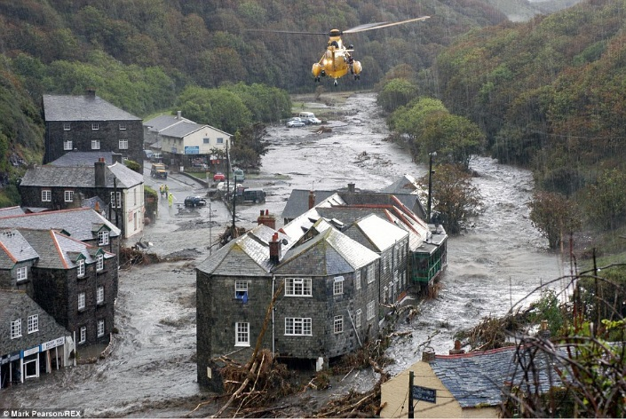
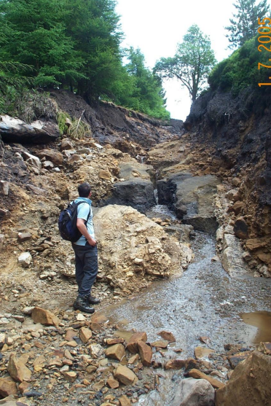
The Hydro-Geomorphic Effects of Storms
Using high resolution rainfall-radar to model fluvial erosion
Declan Valters, David Schultz, Simon Brocklehurst
University of Manchester, United Kingdom
Overview
Challenging the assumption of uniform rainfall input in Landscape + Flood models.
Investigating the landscape response to flooding from severe storms.
Longer term implications of any differences with new model parameterisations.
2-MINUTE MADNESS
J. Hopkins, U. of Durham
Image: Environment Agency (England)
Notes:
The first thing that I’d like address is that often when we use 3d landscape evolution models. or distributed hydrological models, as some call them, we don’t really give much thought to the distribution of rainfall input into the model. As georphologists we tend to be particularly guilty of this. When we represent this spatial variation in rainfall, the landscape respinds differently.
Secondly, in the PICO session later on I’ll show you some case studies where I’ve modelled the landscape response differs using more realistic rainfall inputs.
Thirdly, For those interested in long term landscape evolution, I’d like to talk about how these differences scale up to longer timescales such as drainage basin migration and capture, the growth of mountain ranges and so on.
Here are two of the case studies I’ll be showing you – Boscastle, in the southwest of England from a few years ago, and this is Ryedale in the north of the England after a sever storm and the resulting flood.

Slide 3
Overview
Challenging the assumption of uniform rainfall input in Landscape + Flood models.
Investigating the landscape response to flooding from severe storms.
Longer term implications of any differences with new model parameterisations.
2-MINUTE MADNESS
J. Hopkins, U. of Durham
Image: Environment Agency (England)
Notes:
The first thing that I’d like address is that often when we use 3d landscape evolution models. or distributed hydrological models, as some call them, we don’t really give much thought to the distribution of rainfall input into the model. As georphologists we tend to be particularly guilty of this. When we represent this spatial variation in rainfall, the landscape respinds differently.
Secondly, in the PICO session later on I’ll show you some case studies where I’ve modelled the landscape response differs using more realistic rainfall inputs.
Thirdly, For those interested in long term landscape evolution, I’d like to talk about how these differences scale up to longer timescales such as drainage basin migration and capture, the growth of mountain ranges and so on.
Here are two of the case studies I’ll be showing you – Boscastle, in the southwest of England from a few years ago, and this is Ryedale in the north of the England after a sever storm and the resulting flood.

Slide 4
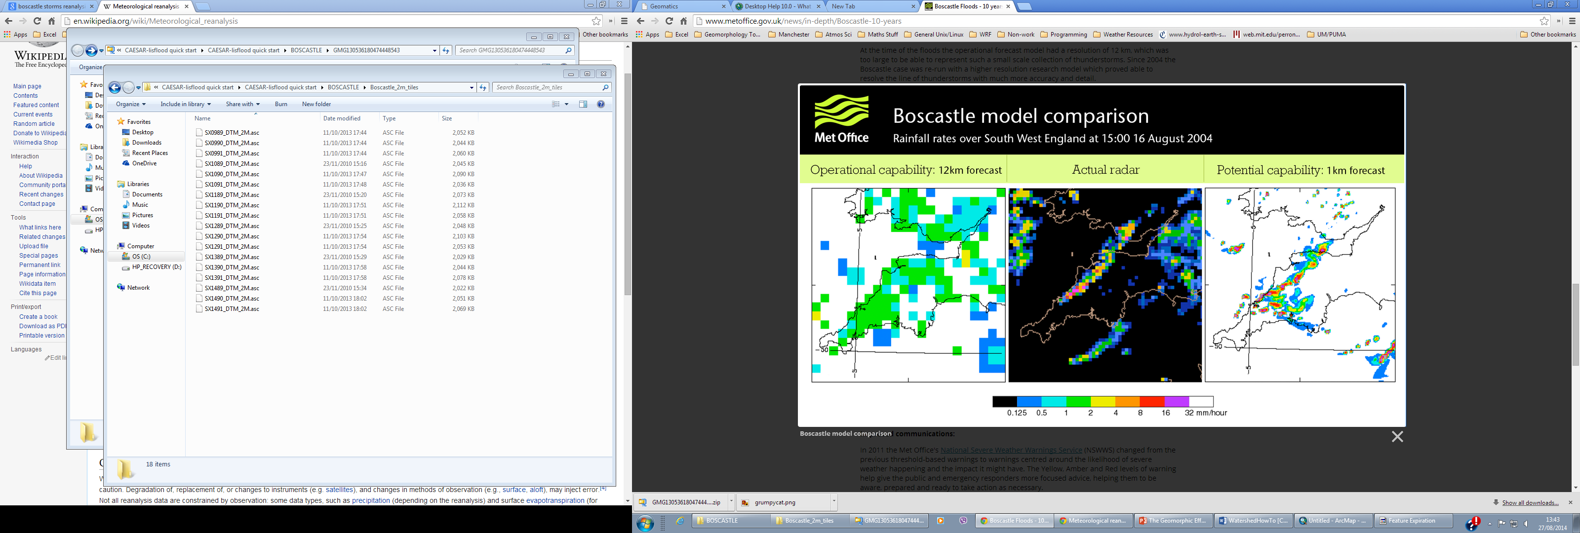

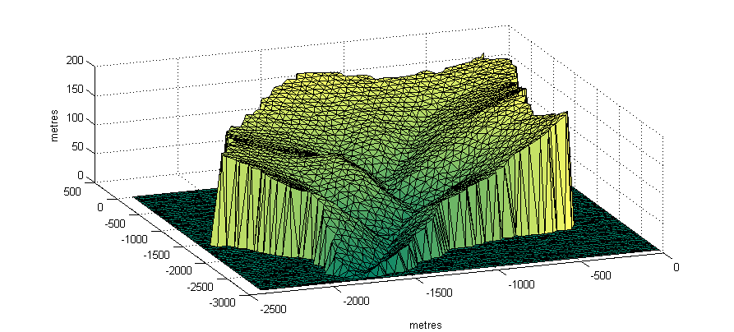
The Hydro-Geomorphic Effects of Storms
Using high resolution rainfall-radar to model fluvial erosion
Declan Valters, David Schultz, Simon Brocklehurst
University of Manchester, United Kingdom
2-MINUTE MADNESS
LANDSCAPE EVOLUTION/
FLOOD MODEL
RAINFALL RADAR
Image: Environment Agency (England)
Notes:
So in keeping with the theme of this session, here’s the novel method that I’ve implemented. Conceptually it’s quite straightforward, rather than using a point value from say a rain gauge, as a value for precipitation input, I use high resolution (1km) rainfall radar as the rainfall input into the model. So the distribution of rainfall, even in relatively small catchments is more accurately represented, compared to using a single sample point.
So come along to my PICO later on and I’ll show you how (or if!) the results differ when using realistic rainfall in hydrologic and landscape evolution models.

Slide 5
Storms: The agents of erosion and landscape evolution
This study is motivated by an interest in quantifying how atmospheric processes drive landscape evolution in humid, temperate environments. It has been established that landscape evolution is punctuated by intense episodes of flooding and erosion. However, little thought is given to the meteorological conditions necessary to trigger ‘geomorphically effective’ events, or to what extent landscapes are sensitive to the details of precipitation.
This study in short:
Here, we demonstrate the advantages of using model simulations with realistic inputs of precipitation data to examine previous severe storm events in the UK in the last decade. While the focus in this presentation is on the short term landscape response to storms, we also invite viewers to consider how differences at this timescale could scale-up to improve our understanding of long term landscape evolution.
Overview
Rainfall Radar – realistic source of rainfall input
Landscape Evolution Model – Coupled with a distributed hydrologic model

Slide 6
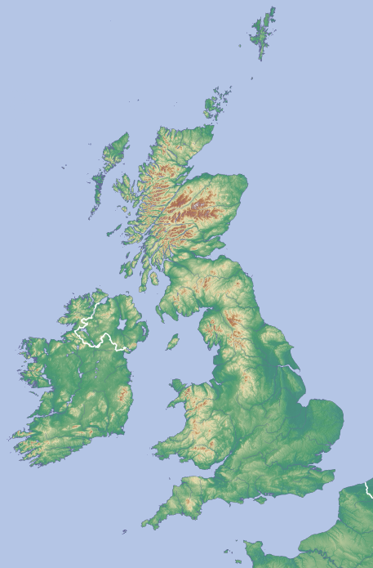
Boscastle, Cornwall: 2004
Touch for results and details
Case Studies in the UK
Ryedale, Yorkshire: 2005
Touch for results and details
Ryedale
Boscastle
J. Hopkins, U. of Durham

Slide 7
Meteorological Setting
Case Studies in the UK: Boscastle 2004
Catchment Setting
Model Results

Slide 8
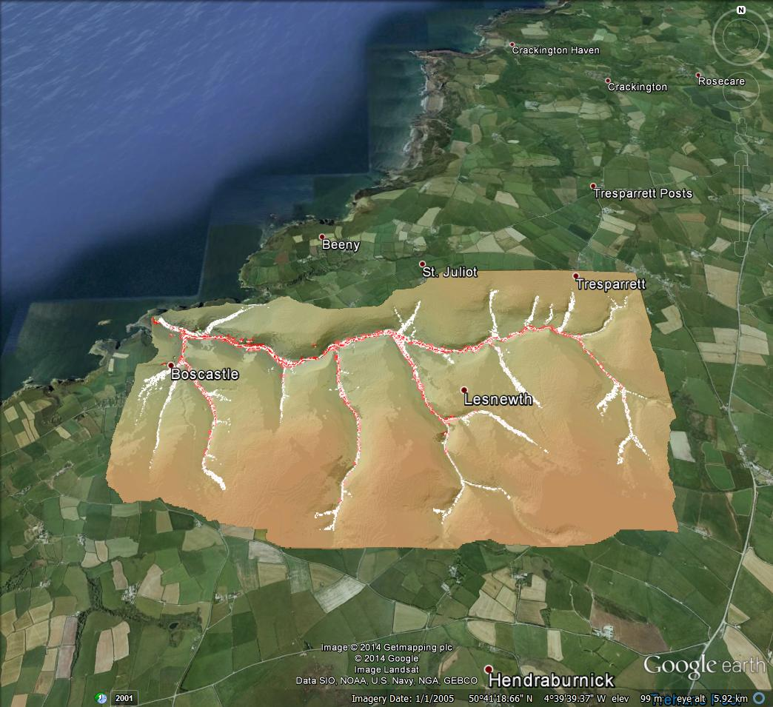
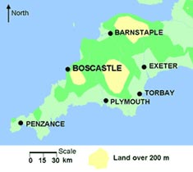
Boscastle: Catchment Setting
Case Studies in the UK: Boscastle 2004
6km

Slide 9
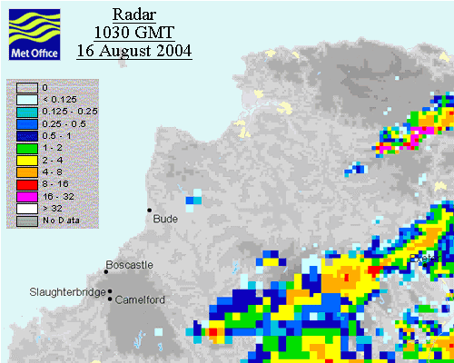
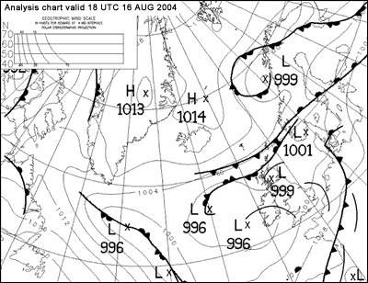
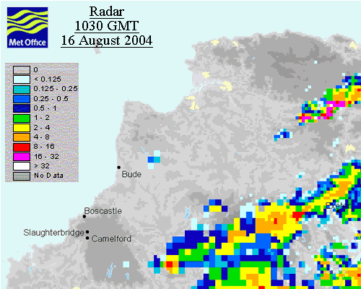
Meteorological Setting
Click on the radar image to view the rainfall activity during the event in action.
Case Studies in the UK: Boscastle 2004
Synoptic Setting. 16th August 2004
The intense rainfall over Boscastle and the Valency catchment was caused by a number of conditions. A slow moving low-pressure system from the south-west brought moist air to the region. Conditions at the smaller scale made it possible for convective cells to repeatedly form over the same small area along the north Cornwall coast, leading to a prolonged period of intense, convective downpours over a small area. (Golding, 2005)

Slide 10
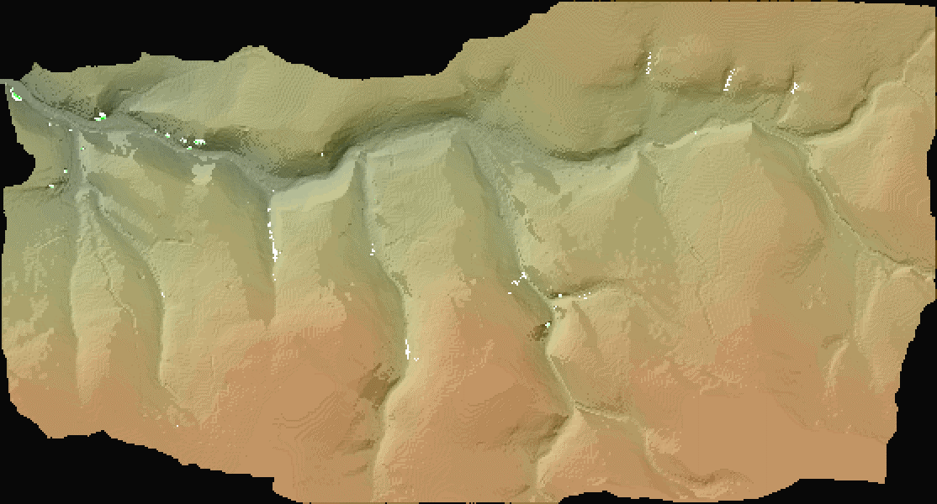

Model Results
Case Studies in the UK: Boscastle 2004

Slide 11
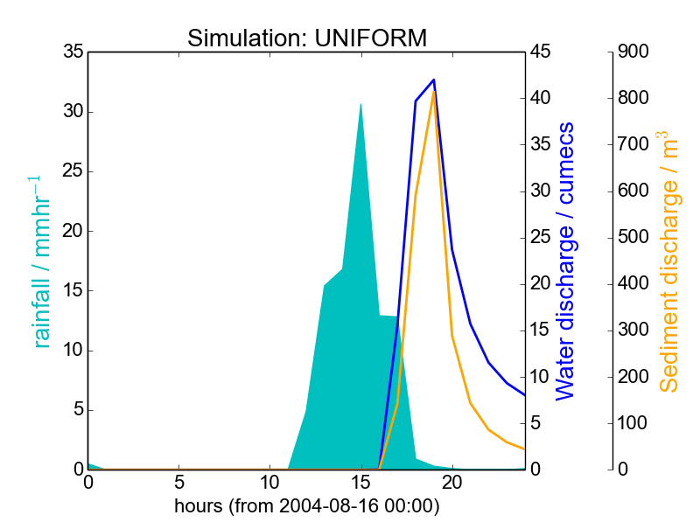
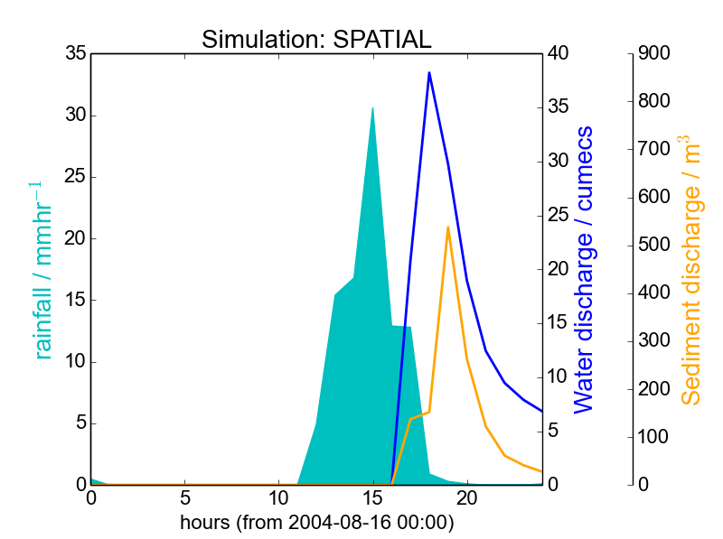
g
Boscastle: Model Results
Water and Sediment Discharge at Catchment Outlet. The simulations used rainfall input from the Met Office NIMROD rainfall-radar system. The top figure is from a simulation using uniform rainfall input, i.e. a average value of rainfall is applied to the whole catchment. The lower figure, uses spatially realistic rainfall inputs, assimilated into the model directly from 1km resolution radar.
When considering water and sediment discharges at a single outlet point (the mouth of the catchment), differences between using realistic rainfall input and uniform rainfall values are small, but in this case the SPATIAL (realistic) rainfall simulation predicted slightly lower sediment flux peaks.
Case Studies in the UK: Boscastle 2004

Slide 12
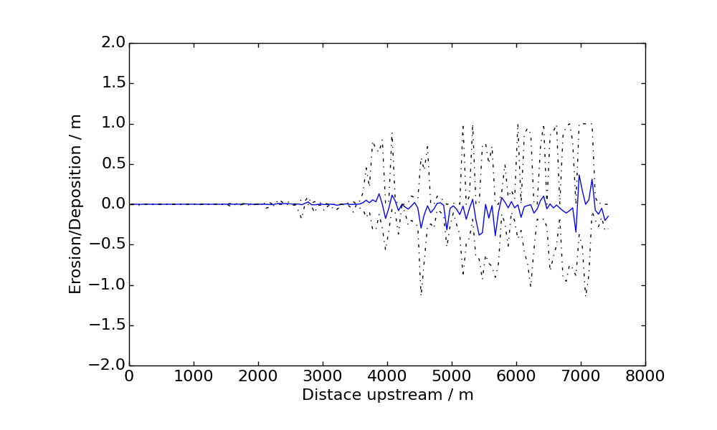
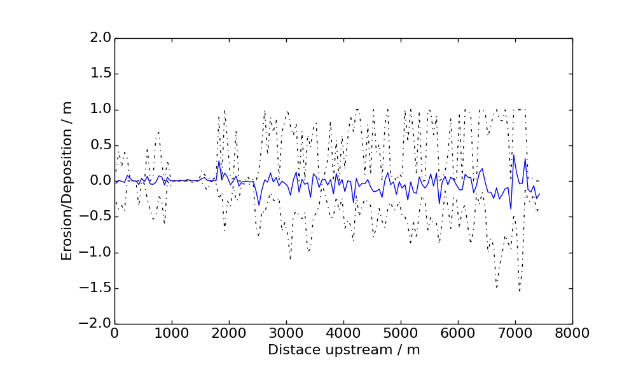
Boscastle: Model Results
Erosion and deposition along channel (River Valency, Boscastle.) Top figure shows the case with spatially variable rainfall from the NIMROD radar input to the model. Lower figure shows the model when using spatially uniform rainfall input. With realistic rainfall distribution, erosion is found to concentrate in the upper reach of the catchment. (Dashed lines show minimum and maximum values)
With spatially realistic rainfall, the wave of erosion does not propagate fully down the channel.
Case Studies in the UK: Boscastle 2004

Slide 13
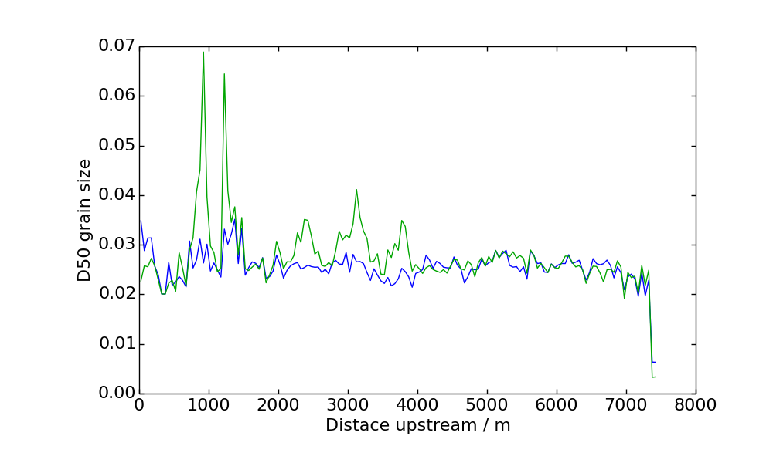
Boscastle: Model Results
Median Grain Size (D50, mm) Distribution along channel (River Valency, Boscastle.) In green is the distribution using realistic rainfall inputs from the NIMROD rainfall radar data. Blue line is using uniform rainfall input. Spatially realistic rainfall case shows larger mean grain size in mid- to lower reaches of the channel.
Case Studies in the UK: Boscastle 2004

Slide 14
Meteorological Setting
Case Studies in the UK: Ryedale 2005
Catchment Setting
Model Results
J. Hopkins, U. of Durham

Slide 15
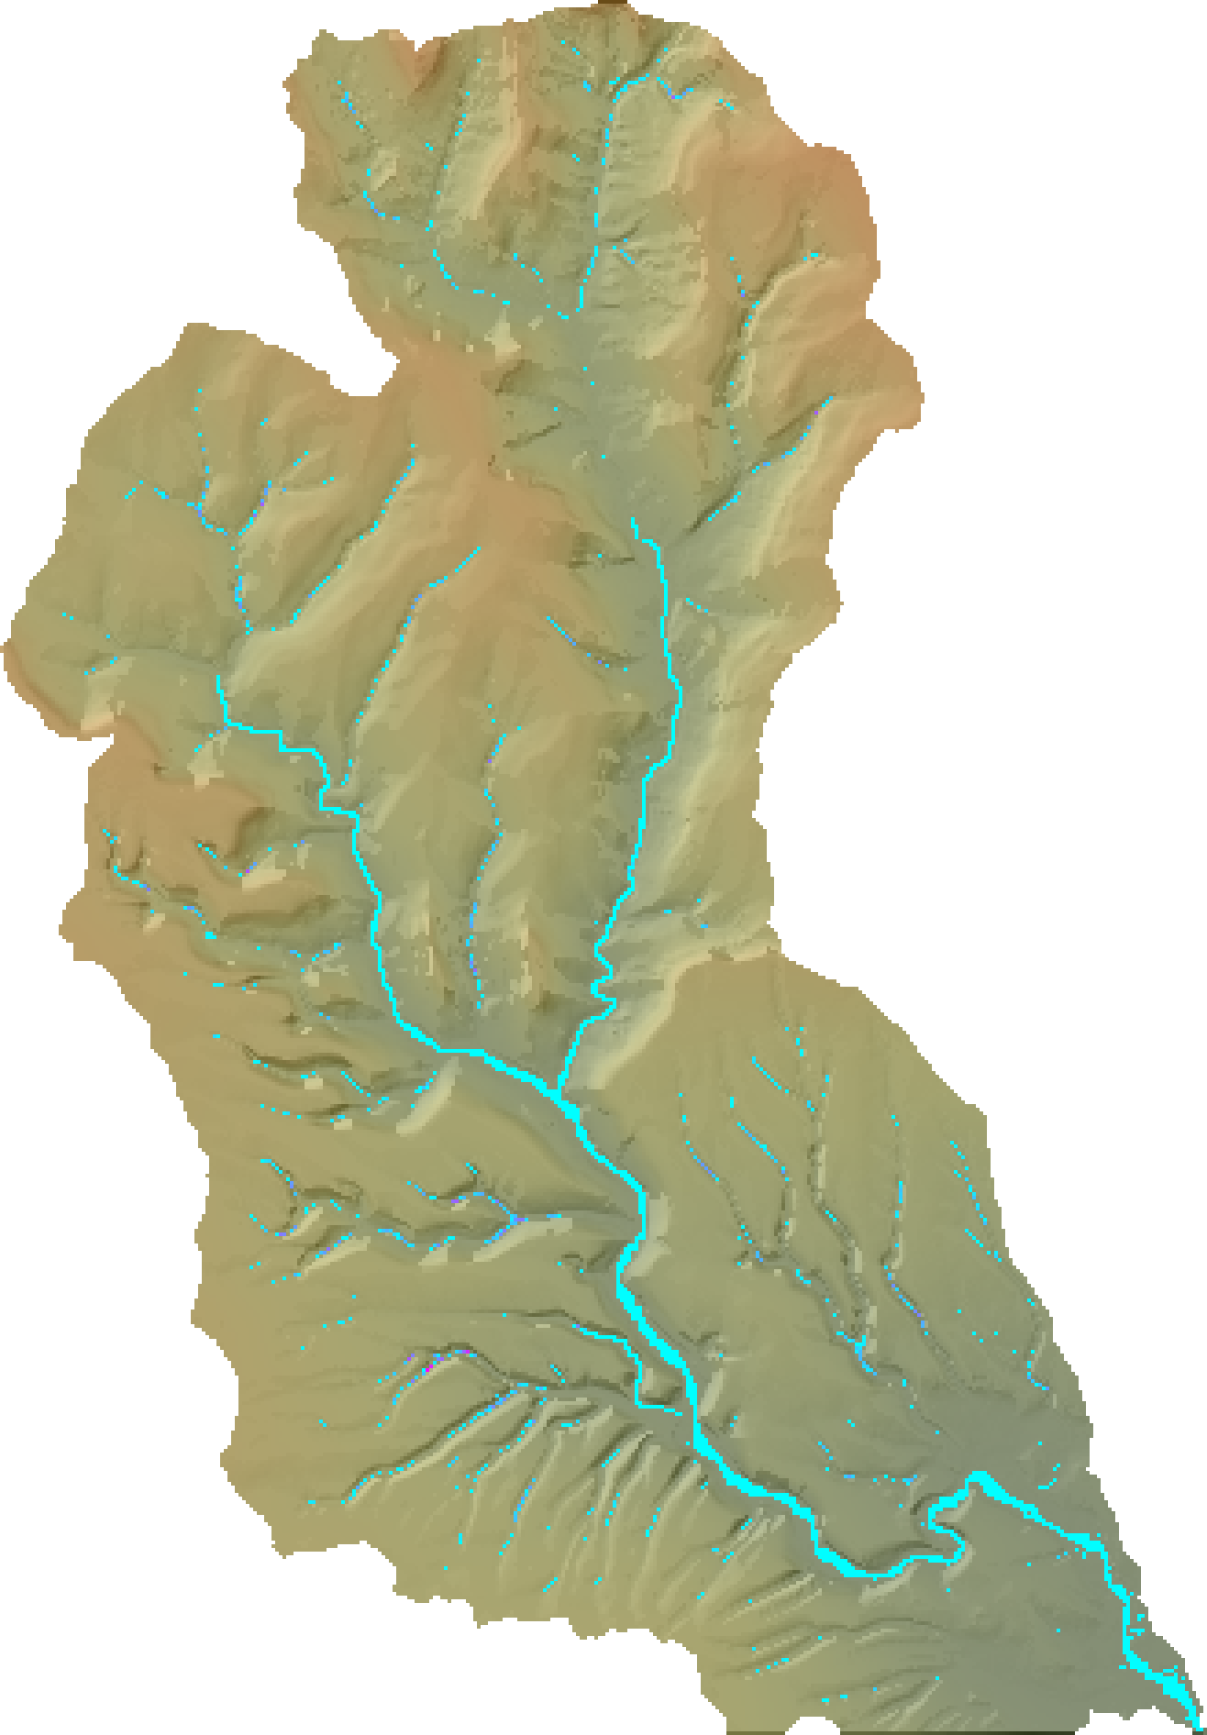
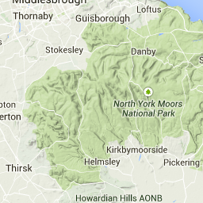
Ryedale: Catchment Setting
15km
Case Studies in the UK: Ryedale 2005

Slide 16
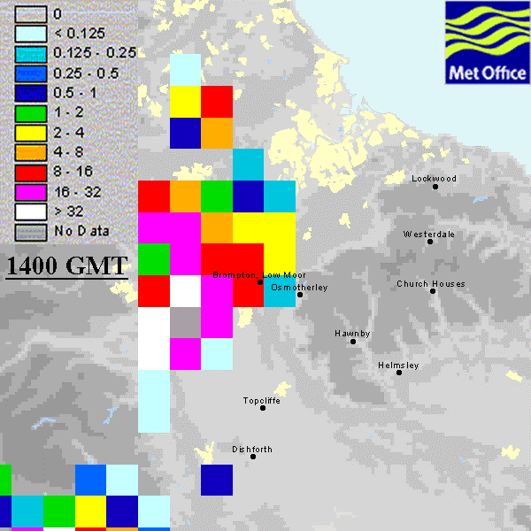
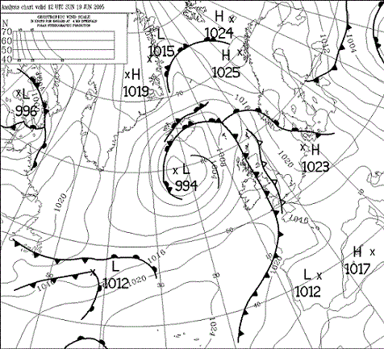

Ryedale: Meteorological Setting
Tap the radar image to view the rainfall activity during the event in action.
Case Studies in the UK: Ryedale 2005
Thunderstorms on 19 June over N. Yorkshire were intensified by a number of meteorological conditions falling into place. A split front developing over the western UK, high surface temperatures, and large moist air masses, resulting in intense convective cells developing over the catchment. This was further enhanced by the advection of a PV anomaly over the top of the convective activity.
Synoptic Setting. 19th June 2005

Slide 17
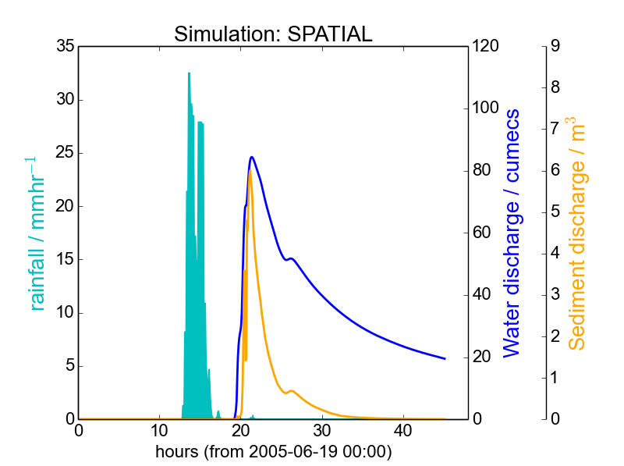
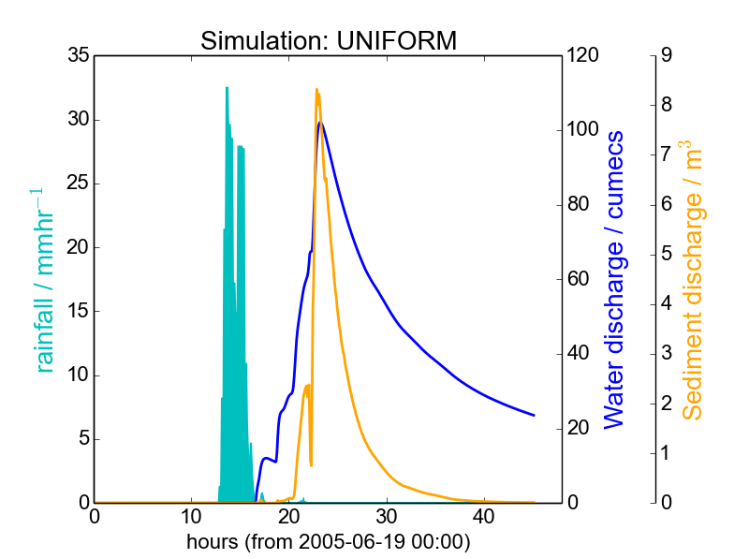
Model Results: RYEDALE
Water and Sediment Discharge, Ryedale Catchment. Simulations use a spatially realistic rainfall distribution (from rainfall radar), and a spatially uniform rainfall input. (averaged from radar). While differences are small, the UNIFORM simulation predicts a higher peak storm flow, and consequently higher sediment output from the basin. Suggested reasons for the discrepancy include: 1) Varying channel response upstream of outlet (pooling, sediment blockages) 2) in the SPATIAL case, highest rainfall values are found on the higher ground, due orographic precipitation: Water is lost before it enters the channel.
Case Studies in the UK: Ryedale 2005

Slide 18
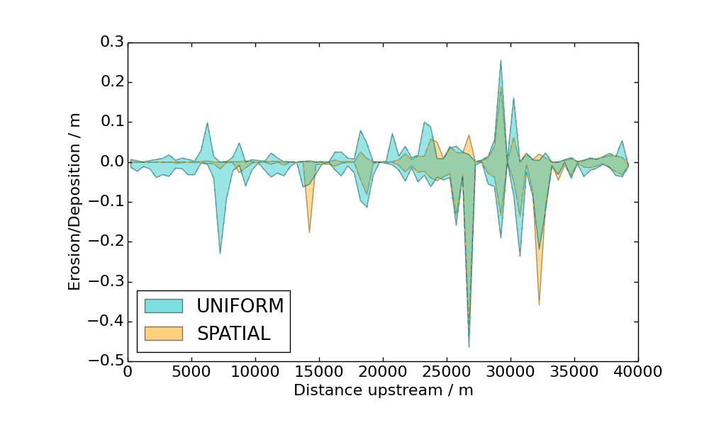
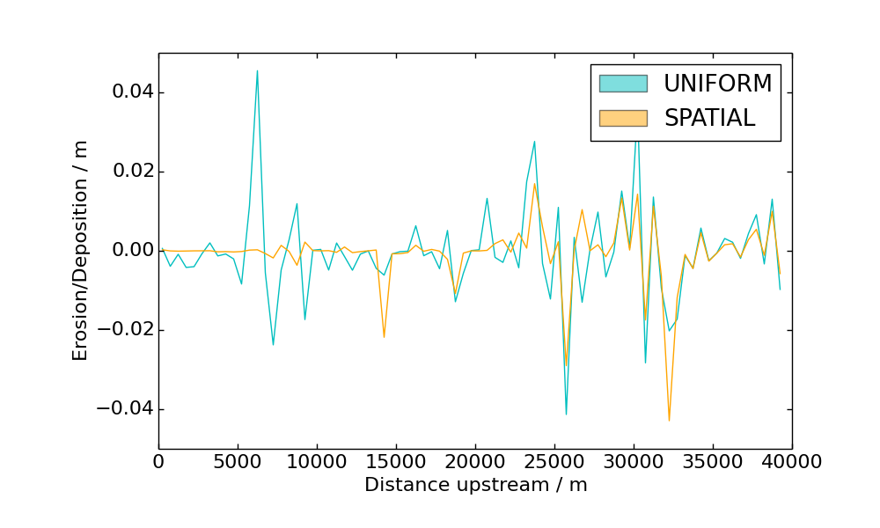
Model Results: RYEDALE 2005
Erosion and deposition along mainstem channel (Ryedale). In the top figure, the minimum and maximum values of net erosion or deposition in the channel are shown. The lower figure shows the mean net erosion or deposition amount., over a 500m channel-binning length. Erosional activity dominates in the upper catchment in the SPATIAL case.
Explanation: In the UNIFORM case, as rainfall is evenly distributed over the catchment, erosional/depositional activity is also evenly distributed.
Case Studies in the UK: Ryedale 2005

Slide 19
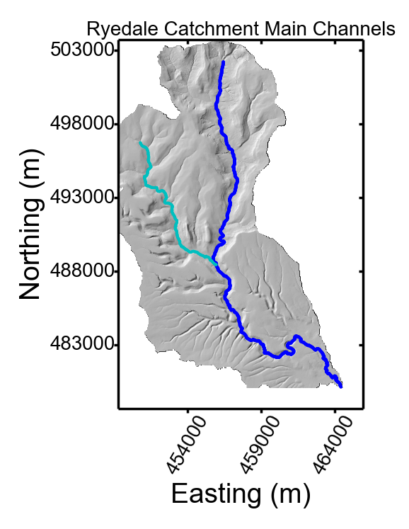
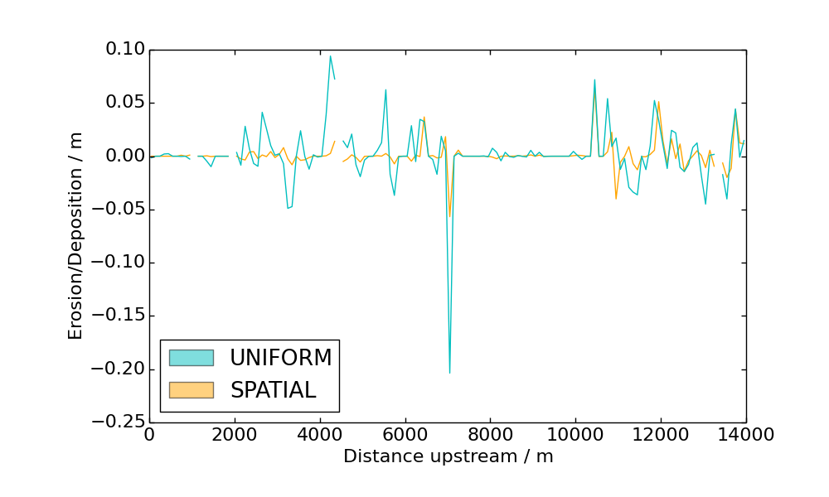
Model Results: RYEDALE
Spatial variation in erosion distribution. The weather system moves in a westerly track. It is possible that different erosion rates are observed outside the main channel (marked in dark blue in the figure below right). Here, erosion and deposition amounts in the smaller tributary to the West is shown (light blue in the figure below right).
Case Studies in the UK: Ryedale 2005

Slide 20
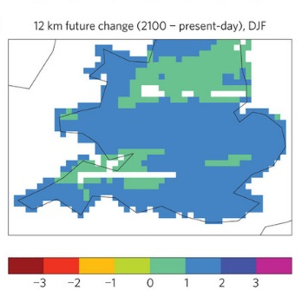
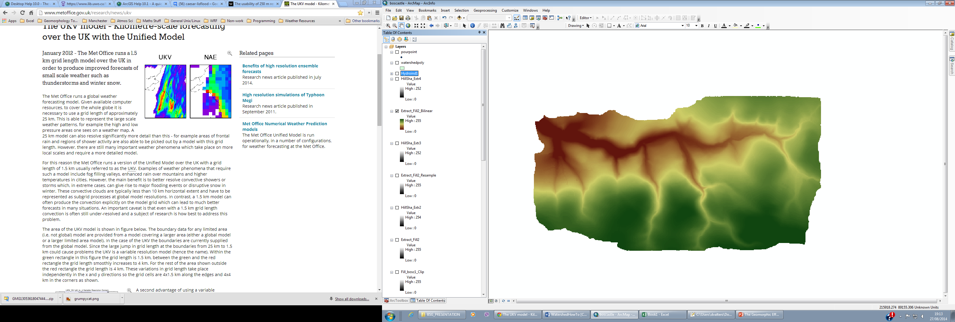
Presented Here:
NIMROD
Rainfall Radar
Potential model coupling applications
Weather Forecasting
Model
Regional
Climate Model
Modelling Framework
CAESAR-Lisflood
Landscape
Evolution Model
(Coulthard et al 2013)
Data Coupling Framework

Slide 21
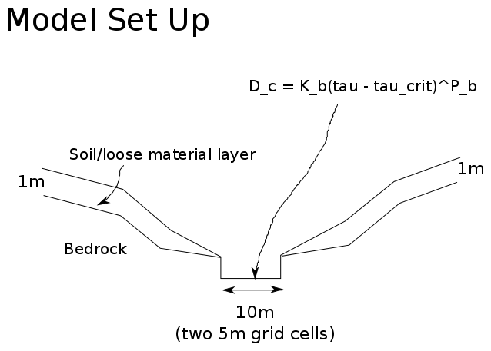
Model Coupling Framework
Workflow
Catchment of interest extracted from DEM.
Corresponding radar data extracted from archive
Radar data converted to intermediate format for assimilation into hydro/landscape evolution model.
The model runs, assimilating the radar data into the catchment hydrology model, which distributes it across the landscape.
Analysis of output files, DEMs of difference, erosion mapping.
Modelling Framework
Landscape evolution model
I use a slightly modified version of the CAESAR-Lisflood model.
The modification includes a routine to simulate bedrock erosion according to the Stream Power Law. (Pictured left)

Slide 22
Conclusions
Conclusions
Uniform rainfall distribution across catchments (even smaller ones) is an unrealistic assumption for many purposes.
Using spatially realistic rainfall distributions, model simulations suggest subtly different hydrograph peaks and shapes.
Geographic distribution of erosion and sedimentation in catchment is affected by rainfall distribution.
In simulations, overall erosive effect is lower in catchments with spatially realistic rainfall.
This may be due to orographic preference for rainfall on higher ground, further from river channels.
Conclusions

